Slide 1
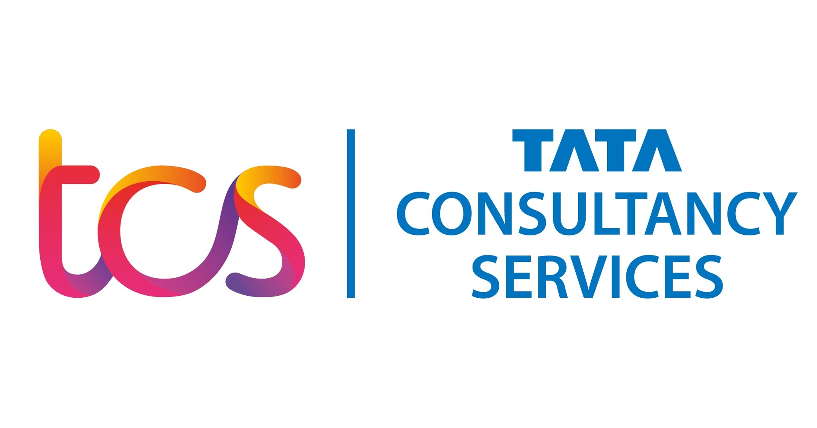

Slide 2
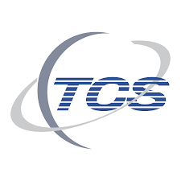
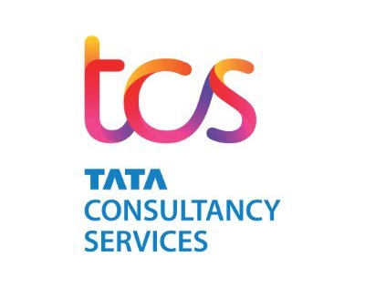
SUBMITED TO TUSHARA MAAM
SUBMITTED BY-
Anjali Yadav
mushkan
sayan
sushil
kunal

Slide 3
Milestone 1 TCS Industry Overview
TCS is an IT services, consulting and business solutions organization partnering many of the world’s largest businesses in their transformational journeys for the last 50 years. It has a global presence, deep domain expertise in multiple industry verticals and a complete portfolio of offerings – grouped under consulting and service integration, digital transformation services, cloud services, cognitive business operations, and products and platforms – targeting every C-suite stakeholder.
The Company leverages all these and its deep contextual knowledge of its customers’ businesses to craft unique, high quality, high impact solutions designed to deliver differentiated business outcomes. These solutions are delivered using its Secure Borderless Workspaces™ (SBWS™) operating model which enables a highly distributed, Location Independent Agile™ delivery.
TCS geographic footprint covers North America, Latin America, the United Kingdom, Continental Europe, Asia-Pacific, India, and Middle-East and Africa.

Slide 4
TCS considers industry verticals as its go-to-market business segments. The five key vertical clusters are: Banking, Financial Services and Insurance (BFSI), Retail and Consumer Business, Communications, Media and Technology (CMT), Manufacturing and Others. The last category includes Life Sciences and Healthcare, Energy, Resources and Utilities, Public Services and others.

Slide 5
Tata Consultancy Services (Briefly Describe)
Tata Consultancy Services (TCS) is an Indian Multinational information technology (IT) services and consulting company Headquartered in Mumbai. It is a part of the Tata Group and operates in 149 Locations across 46 countries. TCS is the second largest Indian company by market capitalisation and is among the most valuable IT services brands worldwide .
In 2015, TCS was ranked 64th overall in the Forbes World's Most Innovative Companies ranking, making it both the highest-ranked IT services company and the top Indian company. In April 2018, TCS became the first Indian IT company to reach $100 billion in market capitalization and second Indian company ever (after Reliance Industries achieved it in 2007)^{[15]} after its market capitalisation stood at ₹6.793 trillion (equivalent to ₹7.7 trillion or US$100 billion in 2020) on the Bombay Stock Exchange.

Slide 6
TCS SERVICES
IT Services
Asset Based Solutions
Global Consulting
Engineering & Industrial Services
IT Infrastructure
BPO

Slide 7
Analyze and Discuss
Beginning in April, TCS will divided its entire business into four groups: acquisition, relationship incubation, enterprise growth, and business transformation, presenting an industry – first model that moves away from the “traditional three-dimensional (framework) of geography, vertical, or services,” according to the ET sources, while putting a focus on clients, their changing digital needs, and faster delivery times.
“The operating model will be aligned to the customer journey at every step, leaders who have been groomed will lead these new groups” the publication reported.

Slide 8
Sales and Distribution Milestone 2 Report
SALES FORCE STRUCTURE AND MANAGEMENT OF TCS SALESFORCE
1. SALES FORCE STRUCTURE?
The Sales force structure decision is simple, If the company sells only one product line to one industry with customers in many locations. In that case, the company would use a territorial sales force structure. If the company sells many products to many types of customer, it might need either a product sales force structure or a customer sales force structure or a combination of the Two.

Slide 9
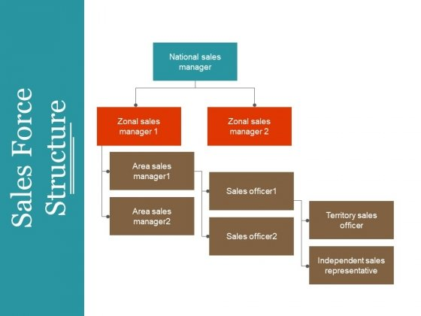
TCS SALES HIERARCHY/STRUCTURE -:

Slide 10

SALES FORCE management
Sales Force Management (SFM) is a sub-system of marketing management. It is Sales Management that translates the marketing plan into marketing performance It is the development of a sales force that includes coordination of sales operations, as well as the training and application of sales methods that result in achieving sales goals and objectives.

Slide 11
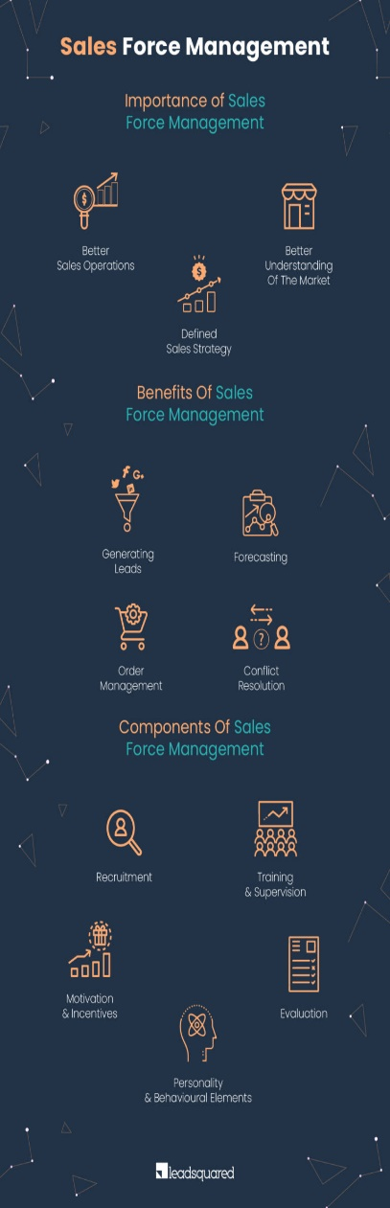
IMPORTANCE OF SALES FORCE MANAGEMENT
Better Sales Operations A better understanding of the market
Defined sales strategy

Slide 12

MANAGING THE SALES FORCE
The first step is setting out an objective for the salesforce:- Earlier companies had a single objective of increasing sales making it an objective also for salespeople. Salespeople are asked to perform a search for prospective clients or leads. Effective communication of products and services is essential to close the deal. Salespeople also play an important role in after-sales service and can make a difference for the company. Salespeople are the eyes and ears of the company in the market gathering information about competition and customer changing demands.
2. Second step is to use salespeople strategically:- Salespeople have to combine efforts with other team members to achieve the objective. Salespeople should be aware of how to analyses market data provided and convert them into marketing strategies.
3. Third step is deciding the structure of the sales force:- The structure of the sales is dependent on the strategy followed by the company.

Slide 13
Like which strategy followed by company
Territorial structure :- Is used where every sales representative is assigned specific geographical area. This structure is preferred for building relationships with locals.
Product structure :- Is used for complex and un- related product portfolio. Here the sales people are directly associated with research and development of the products.
Market structure :- Is used if the companies are operating different industry or market segments. Every sales force specializes in a definite market and helps push a product efficiently across the given market. However, the disadvantage would arise if customers are located over a wide geographical area.
Complex structure :- Is used when companies are in business of selling complex product to different customer across a large geographical area. Here sales force structure is a combination of other structures discussed.

Slide 14
Training Process and Methods of TCS
TCS has different processes and methods of training for Freshers and Experienced employees
Freshers
Aspire – An E-Learning Module for Students
Initial Learning Program (ILP)
Experienced
Enterprise Architects (EA)
Ambassador Corp
Knowledge Management
Books 24x7
Training as a Part of CSR (Inclusive Growth)
TCS Maitree
TCS Udaan

Slide 15
Freshers
Aspire: – An E-Learning Module for Students: TCS Aspire is mandatory for all associates joining TCS as fresher. It is an online interactive pre-learning program for all new recruits which will help them to understand some basic concepts. The course contains 4 modules of IT Foundation skills introduction to Computers, Programming Fundamentals, Problem Solving and Databases. It also has one module on soft skills required by the IT Professionals. The module is used by 35000 fresh recruiters of TCS in the financial year 2013 for enhancing their skills. The modules are available to them in their final semester in their undergraduate program in Engineering.
Initial Learning Program (ILP):- The Initial Learning Program, the strongest and the best assured grooming platform for all new recruits of TCS. The ILP aims to transform fresh engineering graduates from diverse disciplines into software professionals and to initiate them into the TCS way of life. The ILP model has continuously evolved along with the changing needs of the business. Trainees are not only introduced to various technologies, they are also provided with project delivery, project management and business or life skills. The trainees are expected to maintain a log of their daily learning, and this is periodically reviewed by their respective assessors. The trainees are required to attain a pre-defined readiness level for being deployable to projects. Remedial programs are also offered for slow learners so that they can catch up with the expectations.

Slide 16
Experienced
Enterprise Architects (EA): TCS learning and development team in collaboration with Technology Excellence Group has designed the EA Star program that is aimed at building Enterprise Architects. The program was created to cater to the increasing demand for Enterprise Architects, and the demand for TOGAF certified professionals in various project assignments. So far, over 700 employees have gone through the program, enabling career progression for the associates and creating strong architect community in TCS.
Ambassador Corp: TCS Ambassador Corp is a leadership development program, which prepares experienced employees for global sales roles. TCS’s Ambassador Corps Programme focusses on critical business and communication skills and also equips managers to tackle challenges posed by cultural diversity. It offers an accelerated learning curve and trains managers to take their place on the global stage from the day they land in the international marketplace.
Knowledge Management: Knowledge Management is concerned with creating organizational environments for people to share, create and leverage knowledge for innovation and competitive advantage. TCS has developed a web based Enterprise wide Knowledge Management System known as Knowmax, which is available globally to all TCS consultants. This platform encompasses focus on deriving reusable assets. KNOWMAX acts as a central knowledge bank for all projects being executed by TCS and reduces cycle time.
Books 24x7: An extensive, fully searchable web-based reference tool targeted to meet the information needs of TCS employees. It offers a variety of ready-access titles that cover a broad selection of subjects and topics.

Slide 17
Training as a Part of CSR (Inclusive Growth)
TCS Maitree: A number of non-work related employee engagement initiatives such as fun events, sports, cultural activities and volunteering for social causes are organized across the globe under its employee engagement platform known as 'Maitree'. The culture of volunteering helps employee bonding within the organization and reduces stress at work. TCS Maitree encourages associates and their families to look upon themselves as a part of TCS’ extended family. The initiatives undertaken through TCS Maitree cultivate and propagate volunteer-driven, meaningful activities for associates and their families.
TCS Udaan: Project ‘Udaan’, is a joint and novel initiative by National Skill Development Corporation (NSDC) - Government of India and Special Industry Initiative (SII) to help Kashmir youth join the mainstream of corporate India. TCS has been associated with the program since its inception and aims to train and create employment opportunities for at least 850 youth from Jammu and Kashmir, over a 5 year period. The training intervention provides the youth with the requisite knowledge, skills and competencies required in the corporate world over a period of 3.5months.

Slide 18
Methods of recruitment at TCS
Internal Methods
Promotion and transfer
Job posting
Employee Referrals
External Methods
Campus Recruitment
Advertisements
Employment Agencies
Recruitment Consultancies

Slide 19
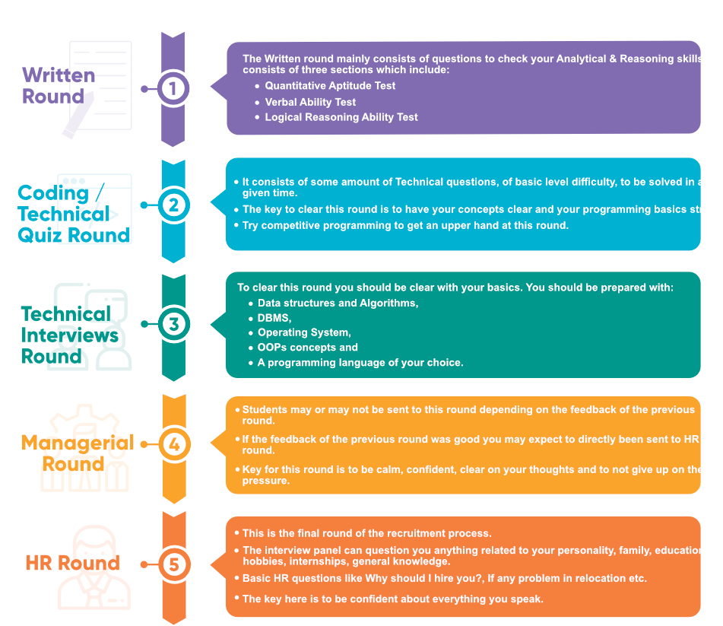
Recruitment process of TCS

Slide 20
Sales and Distribution milestone 3 Report DISTRIUTION MANAGEMENT OF TCS SALES FORCE
Distribution management of TCS
TCS distribution management enable you to focus on re-imagining each area within the supply chain—demand forecasting, replenishment, order management, distribution center operations, and logistics.
Distribution Structure
TCS will divide its entire business into four groups:
Acquisition - Tata Consultancy Services has made 5 acquisitions and 4 investments. The company has spent over $ 98M for the acquisitions. Tata Consultancy Services has invested in multiple sectors such as and more.
Relationship incubation - Our Incubation team identifies and nurtures innovative ideas to build emerging businesses. The TCS Incubation team identifies, nurtures, and builds emerging businesses by leveraging new-age technologies and business models.
Enterprise growth - The IT-BPM industry is expected to hire 3.75 Lakh techies to reach a head count of 4.85 million in FY 2022. The IT sector is expected to have a workforce of 10 million in the next 5 years. TCS, India's largest IT firm, is hiring B.E/ B. Tech freshers across multiple locations.
business transformation - TCS' strategy for enabling all established organizations to move forward with digital transformation is centered on an integrated, modern BFSI platform that enables insurers and other financial services companies to drive sustainable growth through superior customer experiences.

Slide 21
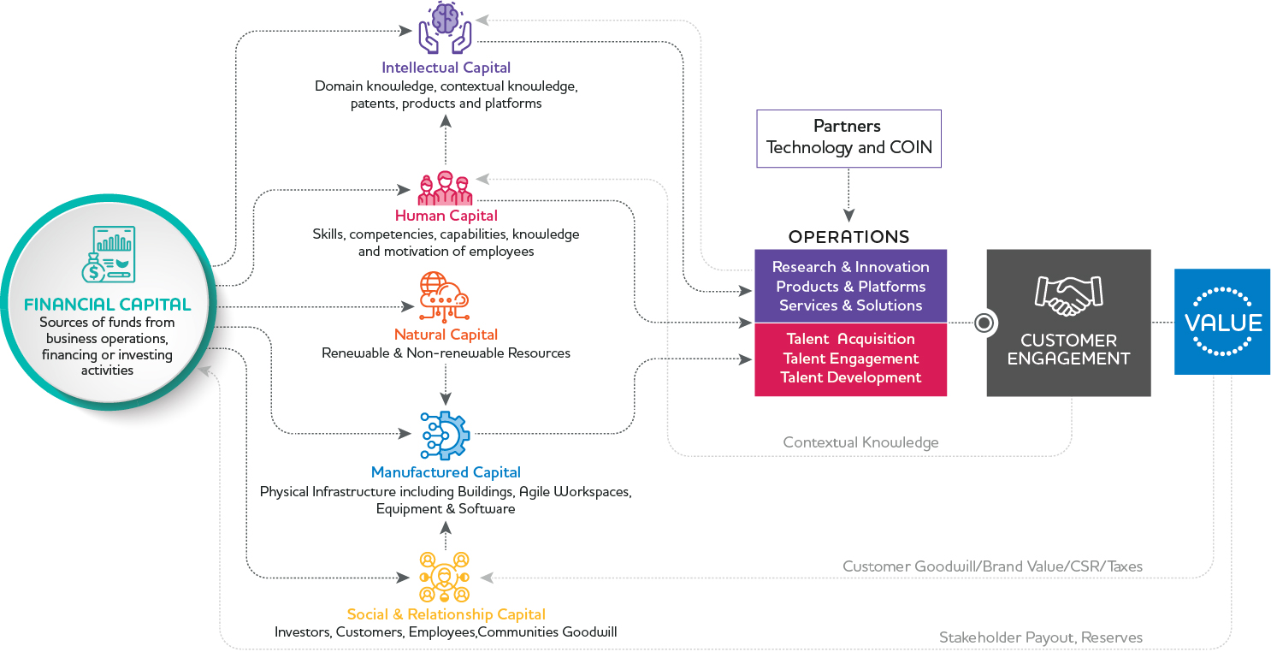
Channel Management
CR2 will become a strategic software partner of TCS. TCS and CR2 will jointly supply IT channel management and ATM solutions to banks worldwide. This partnership will also extend to other channel solutions such as Internet banking and mobile phone banking on a case-by-case basis. "Banks are now beginning to realise that channel management is a vital part of their business strategy," said N Ganapathy Subramaniam, Head of TCS Banking Practice. "By partnering with CR2, TCS will be able to offer a complete channel management solution and thereby deliver a robust banking platform to our customers".
Strategy for Sustainable Growth TCS invests in broadening and deepening customer relationships by continually looking for new areas in their value chain where it can add value, proactively investing in building newer capabilities, reskilling its workforce and launching newer services, solutions, products and platforms.

Slide 22
Functions of TCS
Tata Consultancy Services (TCS) is a software and services provider in India. It is part of the Tata Group, which oversees operations for over 100 companies in seven business sectors: communications and information technology, engineering, materials, services, energy, consumer products and chemicals.

Slide 23
Challenges faced by TCS
Tata Consultancy Services has been struggling to meet market expectations for the last six consecutive quarters and could be trailing the industry growth average this year. While the third quarter is traditionally a weak quarter, the company agrees that some of the growth challenges it is facing may continue for the next few quarters.
There is no taking away from the fact that the quarter was lower than what we expected as well as what the overall market expected,” Rajesh Gopinathan, Chief Financial Officer at TCS, told BusinessLine .

Slide 24


